Slide 1
Health Policy Special Issue on COVID-19
Estonia, Latvia, Lithuania
OBS facilitator: Erin Webb

Slide 2
Agenda
Review Figure 1, "Overview of COVID-19 cases and deaths in the Baltic countries" in terms of which countries to compare over which time period
Discuss key takeaways / conclusion section of the paper
Plan for HSRM presentation on Thursday, 29 October

Slide 3
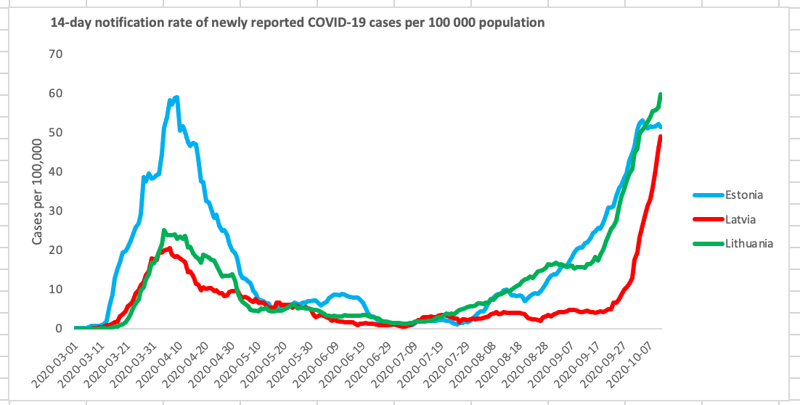
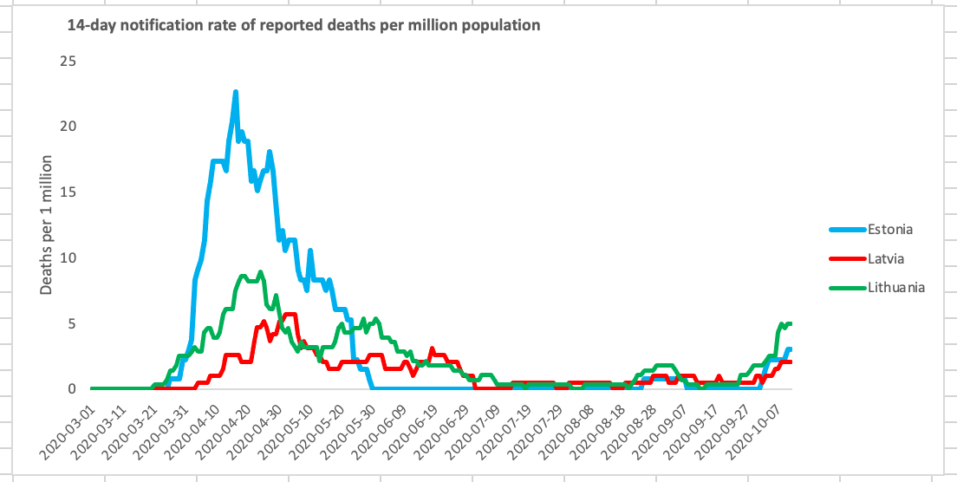
Key decisions:
Will include most recent data
Will use time series graphs similar to Nordic countries (thanks Marina!)
Will largely discuss ‘first wave’ measures although have small paragraph for any measures taken more recently
Source: ECDC

Slide 4
Key takeaways / lessons for policymakers
Early action prevented the situation from escalating (time to build on existing capacity)
Effective testing approaches: testing based on needs (mobile units opening and closing), keeping testing separate from other patients, and scaling up quickly in all countries. State needs to have regulatory authority over testing, regardless of whether tests are conducted in public/private setting
Central planning (and accompanying financial support) and including the scientific community (WHO country office, ECDC) in making prognoses, recommendations, etc. Clear lines of responsibility and paths of escalation within governance are required for an effective response and to avoid mixed messages and duplication of efforts
Locally driven operations for tracing / quarantine / isolation / support was key
Baltic countries are missing a health workforce policy with guidance around pandemic situation. For example, how to distribute workforce in times of shortages? How to use other health care professionals, trainees, retirees, trained professionals working in other fields? How to respond to wards closing if physicians become infected (experience in all countries)? Should doctors/nurses be restricted from working in multiple settings in certain departments (ambulatory center, hospital, elderly homes?) during pandemic?
Note: since this topic was not discussed in depth in the main text, Erin will refer to HSRM for content and potentially reach out if more is needed

Slide 5
HSRM session
Day 3: Thursday, 29 October 2020
16.00 -18.00 | Session 3: Parallel sessions on cross-country papers for SI of Health Policy on country responses to Covid-19. Brief plenary to explain objectives of the sessions Break out into 3 parallel sessions (c. 90 - 110 minutes), as follows: Parallel Session A: Baltic, Nordic and North Atlantic groups Facilitators: Erin Webb, Marina Karanikolos and Gemma Williams Presentation of key findings and lessons by the Baltic countries group: 10 - 12 min Feedback from the other groups and discussion: 25 min Presentation of key findings and lessons by the Nordic countries group: 10 - 12 min Feedback from the other groups and discussion: 25 min Presentation of key findings and lessons by the Nth Atlantics countries group: 10 -12 min Feedback from the other groups and discussion: 25 min
Key decisions:
Erin will prepare slides and present key findings and lessons from Baltic countries
Everyone can join in for feedback from the other groups and discussion!

